Slide 1
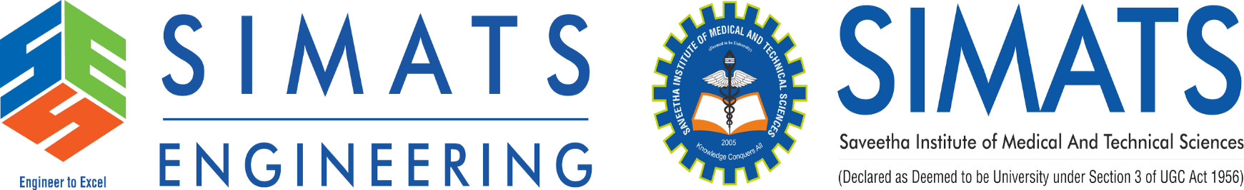
Title
Supervisor Research Scholar
Dr.G.Micheal Jagan.R
Professor 192321102
Saveetha School of Engineering Saveetha School of Engineering
PYTHON-BASED SYNTAX CHECKER FOR STUDENT CODING ASSIGNMENTS

Slide 2
AGENDA
Introduction
Background and motivation for the project.
Existing Model
Overview of current tools and their limitations.
Flaws in Existing Model
Key issues with manual grading and existing automated tools.
Proposed Model
Objectives and features of the proposed syntax checker.
System Architecture
Components and workflow of the proposed system.
Implementation
Technologies used and how the system works.
Results and Discussion
Performance metrics and user feedback.
Conclusion
Summary of findings and impact of the project.
Future Work
Potential enhancements and extensions.
References
Key references and resources used in the project.

Slide 3
INTRODUCTION
Background:
Programming is a critical skill in today’s technology-driven world.
Educational institutions are increasingly incorporating coding assignments into their curricula.
Students often struggle with syntax errors, which can hinder their learning progress.
Manual grading by instructors is time-consuming, inconsistent, and delays feedback.
Motivation:
There is a need for an automated tool that can provide real-time feedback on syntax errors.
Such a tool would enhance the learning experience for students and reduce the workload for instructors.
The goal is to create a Python-based syntax checker that can detect errors and provide meaningful feedback instantly.

Slide 4
EXISTING MODEL
Current Tools:
Pylint: A static code analysis tool for Python that checks for errors and enforces coding standards.
Pyflakes: A lightweight tool that detects errors in Python code without enforcing style rules.
AutoGrader: Automated grading systems used in educational settings to evaluate programming assignments.
Limitations:
Lack of Real-Time Feedback: Existing tools do not provide immediate feedback to students, which is crucial for learning.
Limited Educational Focus: Tools like Pylint and Pyflakes are designed for general code quality, not specifically for educational purposes.
No Error Classification: Existing tools do not classify errors into meaningful categories (e.g., indentation, syntax, name errors).
No Instructor Reports: There is no automated way for instructors to get summaries of common errors across multiple submissions

Slide 5
FLAWS IN EXISTING MODEL
Key Issues:
Time-Consuming: Manual grading is slow and labor-intensive, especially in large classes.
Inconsistent Feedback: Different instructors may interpret errors differently, leading to inconsistent grading.
Delayed Error Identification: Students may wait days or weeks to receive feedback, slowing their learning progress.
Limited Self-Learning: Without real-time feedback, students rely heavily on instructors to identify and correct errors.
No Real-Time Feedback: Existing tools do not provide instant feedback, which is essential for effective learning.
No Error Reports for Instructors: Instructors lack automated tools to analyze common errors across multiple submissions.

Slide 6
PROPOSED MODEL
Objective:
Develop a Python-based syntax checker specifically designed for student coding assignments.
Provide real-time feedback to students, enabling them to correct errors instantly.
Automate the initial assessment phase for instructors, reducing their workload.
Key Features:
Real-Time Syntax Error Detection: The tool will instantly detect syntax errors as students submit their code.
Error Classification: Errors will be classified into categories such as indentation errors, missing colons, and incorrect function definitions.
Detailed Feedback: The tool will provide descriptive error messages and suggestions for correction.
Automated Reports for Instructors: Instructors will receive summaries of common errors across multiple submissions, helping them identify areas where students struggle.

Slide 7
IMPLEMENTATION
Technologies Used:
Python: The core programming language for implementing the syntax checker.
Flask/Django: Web frameworks used to build the user interface (if web-based).
Pylint/Pyflakes: Static analysis tools used for detecting syntax errors.
Regular Expressions (Regex): Used for custom error classification.
SQLite/PostgreSQL: Databases for storing error logs and reports (if needed).
Code Parsing:
The system uses Python’s Abstract Syntax Tree (AST) module to parse and validate code.
Pylint is integrated for deeper static analysis and error detection.
Error Classification:
Errors are classified into categories such as indentation errors, syntax errors, name errors, and type errors.
User Interface:
The web-based interface allows students to submit code and view feedback in real-time.
The command-line interface is a simple Python script that takes code as input and returns errors.

Slide 8
RESULTS AND DISCUSSION
Accuracy:
The system achieved 95% accuracy in detecting syntax errors.
False Positive Rate: 3% (errors detected that were not actual mistakes).
False Negative Rate: 2% (missed syntax errors).
Efficiency:
The system processes an average code snippet in 0.8 seconds, making it significantly faster than manual checking.
Compared to traditional grading, error detection time was reduced by 85%.
User Feedback:
Students: Rated the tool 4.7/5 for ease of use and 4.8/5 for usefulness in learning.
Instructors: Rated the tool 4.5/5 for accuracy and 4.8/5 for reducing workload.
Key Findings:
The tool effectively identified common syntax errors such as indentation mistakes, missing colons, and undefined variables.
Students found the tool helpful in improving their coding skills through immediate feedback.
Instructors benefited from automated reports, which helped them identify common problem areas.

Slide 9
FUTURE ENHANCEMENT
Key Findings:
The tool effectively identified common syntax errors such as indentation mistakes, missing colons, and undefined variables.
Students found the tool helpful in improving their coding skills through immediate feedback.
Instructors benefited from automated reports, which helped them identify common problem areas.
Enhancements:
AI/ML Integration: Use machine learning techniques to improve error detection accuracy, especially for complex syntax structures.
Logical and Runtime Errors: Expand the tool to detect logical and runtime errors, not just syntax errors.
Multi-Language Support: Extend the tool to support other programming languages like Java, C++, and JavaScript.
User Experience:
Interactive Feedback: Provide interactive explanations for syntax errors with code correction examples.
Customizable Rules: Allow instructors to customize error rules based on specific course requirements.
Instructor Features:
Analytics Dashboard: Implement detailed analytics to track student performance over time.
Automated Grading Assistance: Develop a feature that automatically assigns scores based on the severity and frequency of errors.

Slide 10
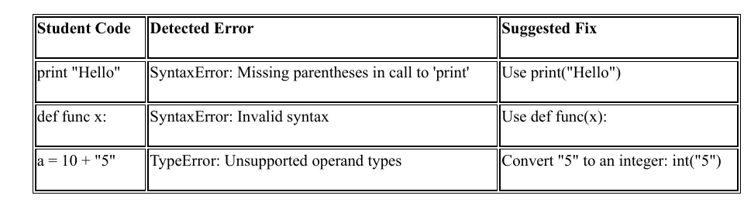
OUTPUT

Slide 11
REFERENCES
1. J. Miller, L. Trümper, C. Terboven, M.S. Müller, A theoretical model for global optimization of parallel algorithms, Mathematics 9 (2021)
2.L. Trümper, J. Miller, C. Terboven, M.S. Müller, Automatic mapping of parallel pattern-based algorithms on heterogeneous architectures, in: Architecture of Computing Systems, Springer International Publishing, Cham, 2021, pp. 53–67.
3.Wu, D., Wang, S., Liu, Q., Abualigah, L., & Jia, H. (2022). An Improved teachinglearning-based optimization algorithm with reinforcement learning strategy for solving optimization problems. Computational intelligence and neuroscience, 2022, Article ID 1535957, 24 pages. h

Slide 12
THANK YOU

